Slide 1

DMS CAPSTONE PROJECT
E-Commerce Order Management System
Under The Guidance Of :
Name of the Faculty
Assistant Professor
Department of IT&DS
Aditya University
Team roll numbers and name

Slide 2

Project Abstract
The E-Commerce Order Management System is a relational database designed to efficiently manage and organize the core operations of an e-commerce business. The system maintains connected information about customers, suppliers, categories, products, inventory, orders, order items, and payments.
The database helps maintain accurate relationships between these entities, making it easier to manage product information, monitor inventory, process customer orders, track individual order items, and record payment details.
Core Database
8 Business Tables
CUSTOMER
SUPPLIER
CATEGORY
PRODUCT
INVENTORY
ORDERS
ORDER_ITEM
PAYMENT
Core System
Customer → Order → Order Item → Product Category → Product Supplier → Product Product → Inventory Order → Payment

Slide 3
Problem Statement
Managing an e-commerce business involves handling large amounts of customer, supplier, product, inventory, order, and payment data. When this information is stored or managed separately, it can lead to data duplication, inconsistency, difficulty in tracking orders, and poor inventory management.
Therefore, a structured relational database is required to organize the data, maintain relationships between different entities, and provide reliable access to important e-commerce information.
Objectives
Organize e-commerce data
Manage customers and suppliers
Manage products and categories
Track inventory and orders
Store order and payment information
Maintain data relationships and integrity

Slide 4
Entities & Attributes
Entity | Main Attributes
CUSTOMER | ID, First Name, Last Name, Email, Phone
SUPPLIER | ID, Name, Contact Email, Phone
CATEGORY | ID, Name, Description
PRODUCT | ID, Category ID, Supplier ID, Name, Price, SKU
INVENTORY | ID, Product ID, Warehouse Location, Quantity
ORDERS | ID, Customer ID, Order Date, Status, Total Amount
ORDER_ITEM | ID, Order ID, Product ID, Quantity, Unit Price, Subtotal
PAYMENT | ID, Order ID, Payment Method, Amount, Payment Status

Slide 5
Tables, Keys & Constraints
🔑 Primary Keys
CUSTOMER → CUSTOMER_ID
SUPPLIER → SUPPLIER_ID
CATEGORY → CATEGORY_ID
PRODUCT → PRODUCT_ID
INVENTORY → INVENTORY_ID
ORDERS → ORDER_ID
ORDER_ITEM → ORDER_ITEM_ID
PAYMENT → PAYMENT_ID
🔗 Foreign Keys
PRODUCT → CATEGORY_ID
PRODUCT → SUPPLIER_ID
INVENTORY → PRODUCT_ID
ORDERS → CUSTOMER_ID
ORDER_ITEM → ORDER_ID
ORDER_ITEM → PRODUCT_ID
PAYMENT → ORDER_ID
Constraints
PRIMARY KEY • FOREIGN KEY • NOT NULL • UNIQUE • CHECK • DEFAULT
These constraints maintain data integrity and consistency.

Slide 6
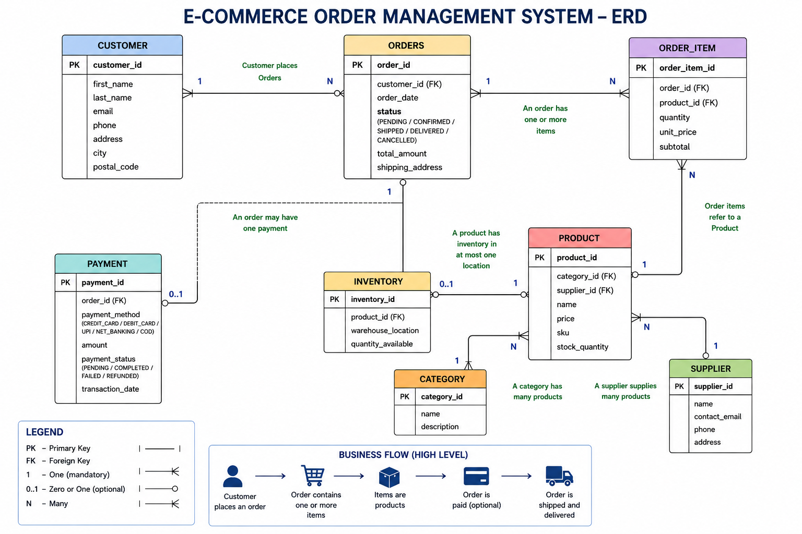
Entity Relationship Diagram

Slide 7
Relationships & Cardinality
Relationship | Cardinality
CUSTOMER → ORDERS | 1 : N
CATEGORY → PRODUCT | 1 : N
SUPPLIER → PRODUCT | 1 : N
PRODUCT → INVENTORY | 1 : 1
ORDERS → ORDER_ITEM | 1 : N
PRODUCT → ORDER_ITEM | 1 : N
ORDERS → PAYMENT | 1 : 1
Key Relationship
ORDERS ↔ ORDER_ITEM ↔ PRODUCT
ORDER_ITEM acts as the bridge between orders and products.
Example:
A customer can place multiple orders.
An order can contain multiple order items.
A product can appear in multiple order items.

Slide 8
SQL Commands & Data Operations
1. CREATE – Create Tables
CREATE TABLE CUSTOMER (...);
CREATE TABLE SUPPLIER (...);
CREATE TABLE CATEGORY (...);
CREATE TABLE PRODUCT (...);
CREATE TABLE INVENTORY (...);
CREATE TABLE ORDERS (...);
CREATE TABLE ORDER_ITEM (...);
CREATE TABLE PAYMENT (...);
2. INSERT — Add Data
Used to insert records into the tables.
INSERT INTO CATEGORY (name, description)
VALUES ('Electronics', 'Electronic products');
INSERT INTO PRODUCT
(category_id, supplier_id, name, price, sku)
VALUES
(1, 1, 'Wireless Earbuds Pro', 2499.00, 'WEP001');
6. UPDATE — Modify Data
Used to update existing records.
UPDATE INVENTORY
SET quantity_available = 50
WHERE product_id = 1;
3. SELECT — Retrieve Data
Used to insert records into the tables.
SELECT * FROM CUSTOMER;
SELECT * FROM PRODUCT;
SELECT * FROM ORDERS;
5. ORDER BY — Sort Data
Used to arrange query results.
SELECT product_id, name, price
FROM PRODUCT
ORDER BY price DESC;
4. WHERE — Filter Data
Used to retrieve records matching a condition.
SELECT *
FROM PRODUCT
WHERE price > 1000;

Slide 9
SQL Commands & Data Operations
7. DELETE — Remove Data
Used to remove unwanted records..
DELETE FROM PAYMENT
WHERE payment_status = 'FAILED';
Database Operations Flow
CREATE → INSERT → SELECT → FILTER → SORT → UPDATE → DELETE → COMMIT
Other SQL Features Implemented
Primary Keys
Foreign Keys
NOT NULL
UNIQUE
CHECK
DEFAULT
Indexes
Generated SUBTOTAL
Inventory Update Trigger
8. COMMIT — Save Changes
Used to permanently save database modifications.
COMMIT;

Slide 10
Conclusion
The E-Commerce Order Management System provides a structured relational database for managing the major activities of an e-commerce business. It organizes and connects important information related to customers, suppliers, product categories, products, inventory, orders, order items, and payments.
The system maintains clear relationships between these entities using primary keys and foreign keys, ensuring data consistency and integrity. It also supports essential database operations such as creating tables, inserting records, retrieving and filtering data, updating information, and managing transactions, providing a reliable foundation for efficient e-commerce data management.

